Slide 1
CPRS Requirements for MVP
Treater: i.e., Psychiatrist, Psychotherapist, Group Leader
Treater: i.e., Psychiatrist, Psychotherapist, Group Leader

Slide 2
Session Preparation (before the patient and provider are in the treatment room):
1- As a Treater have ability to review today’s/history Patient PHQ score
Patient Name
Patient identifying info
Clinician associated with PHQ
Today’s PHQ date, completion time, progress, status
Alerts
2- As a Treater have ability to review today’s/history Patient PHQ item scores
3- As a Treater have become aware of ‘red flags’/details (including action) associated with PHQ suicide item score
4- As a Treater have become aware of ‘red flags’ / (details (including action) associated with treatment progress

Slide 3
Visualization of Session Preparation (before the patient and provider are in the treatment room):
Inspired by eScreening
search
Refresh/Last Refreshed Date/Time
Risk Score | Veteran | SSN-4 | Clinician | Assessment | Assessment Change Date | Duration (Completion Time) | Progress (PHQ) | Status | Alert
TBD | Last Name, First | 1111 | Last, First | PHQ | Date | 06 min: 45 sec | 100% | Complete | PHQ suicide Flag Treatment progress Flag
Click to CPRS patient chart
Click to PHQ history for patient
Click to specific patient data that triggered alert and actionable recommendation
Sort and Filter

Slide 4
In Therapy Session (patient and provider are in the treatment room):
1- As a Treater have ability to show today’s/history PHQ item scores to Patient during therapy session

Slide 5
Visualization of in-Session (patient and provider are in the treatment room):
Inspired by eScreening
Today’s PHQ score with item score in Table
Today’s + history PHQ score with item score in Table
Today’s + history PHQ score with item score in Graph
Toggle Table and Graph

Slide 6
In Therapy Session and/or After Therapy
1- As a Treater have to record Patient Report Outcome of PHQ – previous slides – PHQ score + items for Note will be required to sign off note.
2 – As a Treater have to record focus of session. MVP focus on Depression – These response options will come from psychotherapy Tools Item. This will be a required field.
Do we need trackability of who entered, when they entered (i.e., information that comes with health factor?)
3- As a Treater have to record psychotherapy intervention provided MVP focus on Depression – These response options will come from psychotherapy Tools Item. This will be a required field.

Slide 7
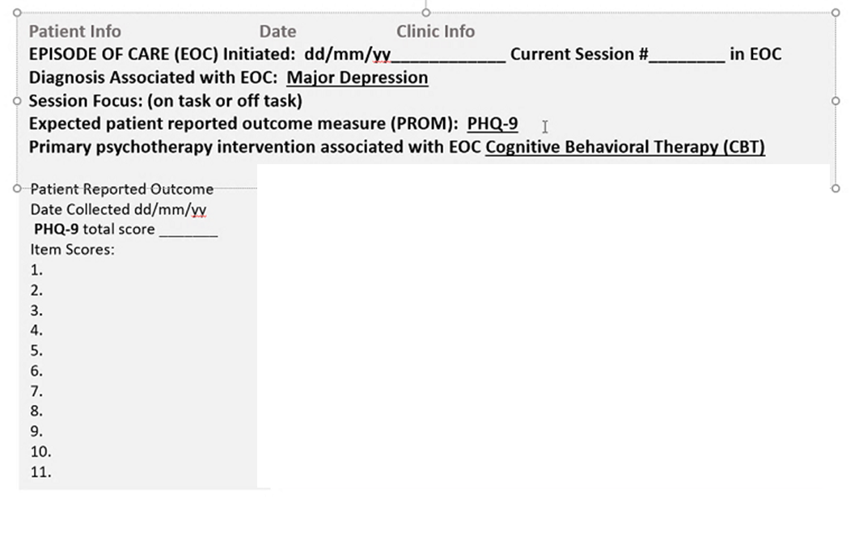
Visualization of in-Session (patient and provider are in the treatment room):
Inspired by Kas demo of CPRS and Dr. Crow image
CPRS Template
CPRS Progress Note

